Slide 1

HIMGIRI AIRCONDITIONING CO PVT LTD
SPECIALIST IN ELECTRICAL AIRCONDITIONING FOR COMMERCIAL
AND RESIDENTIAL PROJECTS.

Slide 2
MEP CONTRACTING
We are pleased to introduce ourselves as the Electrical and HVAC SERVICE PROVIDER situated in Mumbai and Kolkata.
Our Group company is dealing for ELECTRICAL , NETWORKING, PA SYSTEM AND HVAC in Kolkata and MUMBAI in the name of Himgiri Airconditioning Co Pvt Ltd .
Our Mission is to provide Superior Quality services for our Customers by meeting customer requirements in design, time schedule, prompt after sales .
At Himgiri Airconditioning Co Pvt Ltd, we believe in Total Compliance. Our quality assurance practices ensure we follow systematic procedures and business processes, to provide quality work product to all our valued clients.
Our goal is to provide quality engineering with most reliable and efficient resources, to meet our total compliance objective. HIMGIRI strives hard to deliver high performing installations, project set-ups, and superior quality products and possibly exceed customer’s expectations each time.
To address new challenges and achieve continuous progress in delivering quality services to its clients, HIMGIRI reviews its quality objectives and targets regularly. This is accomplished though quality audits on all administrative activities and operational activities across functions.
Your solid heartful moral patronage would be helps us to reach the goal.

Slide 3
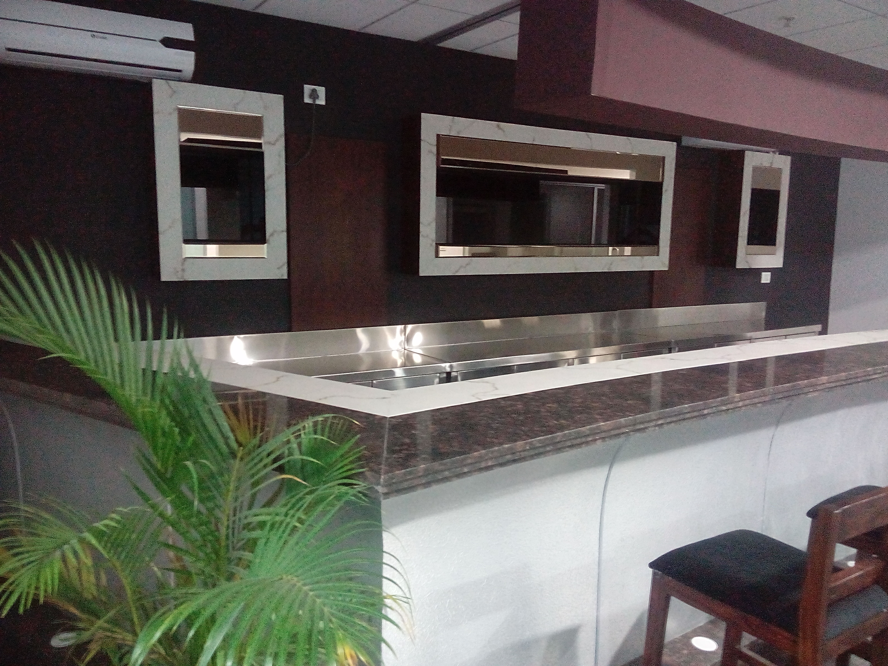
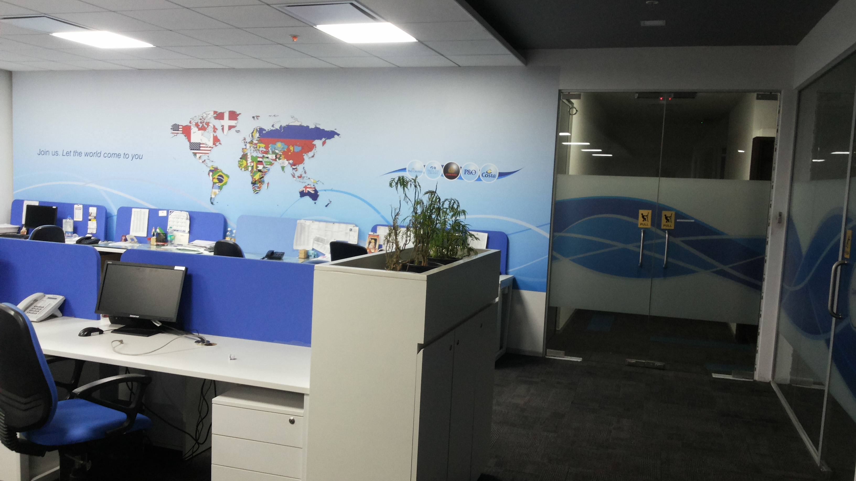
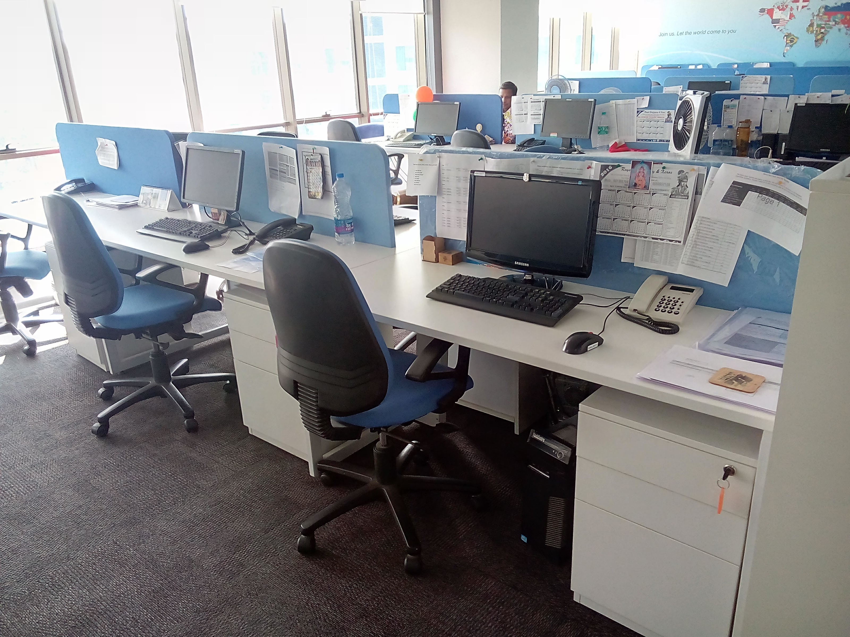
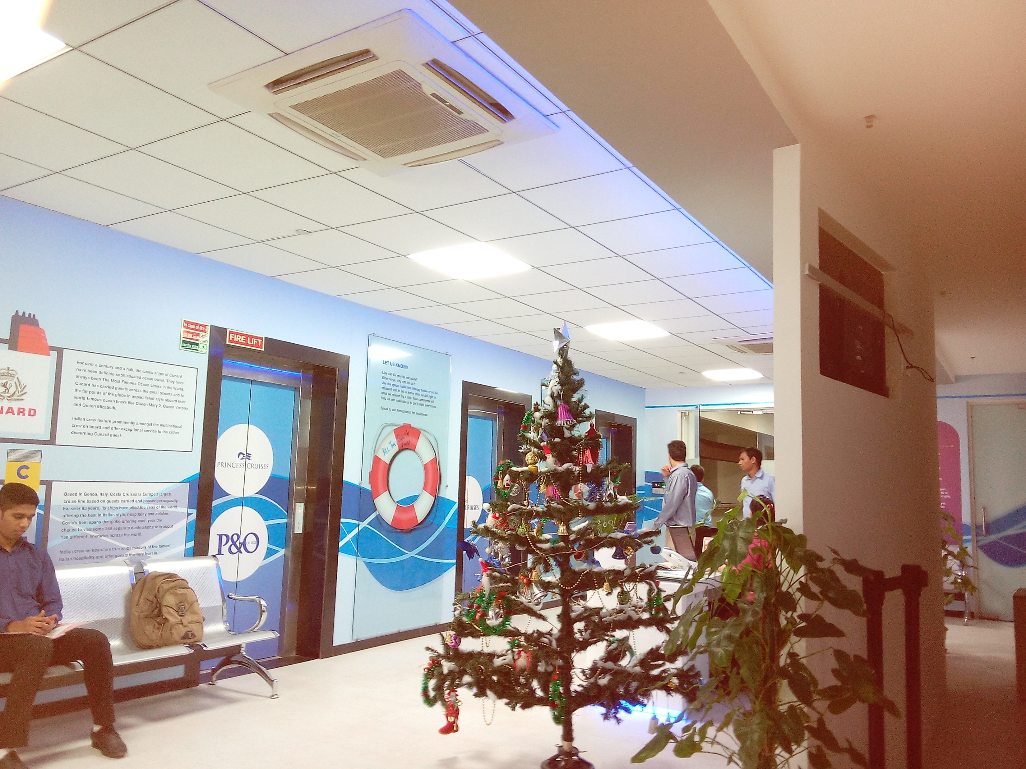
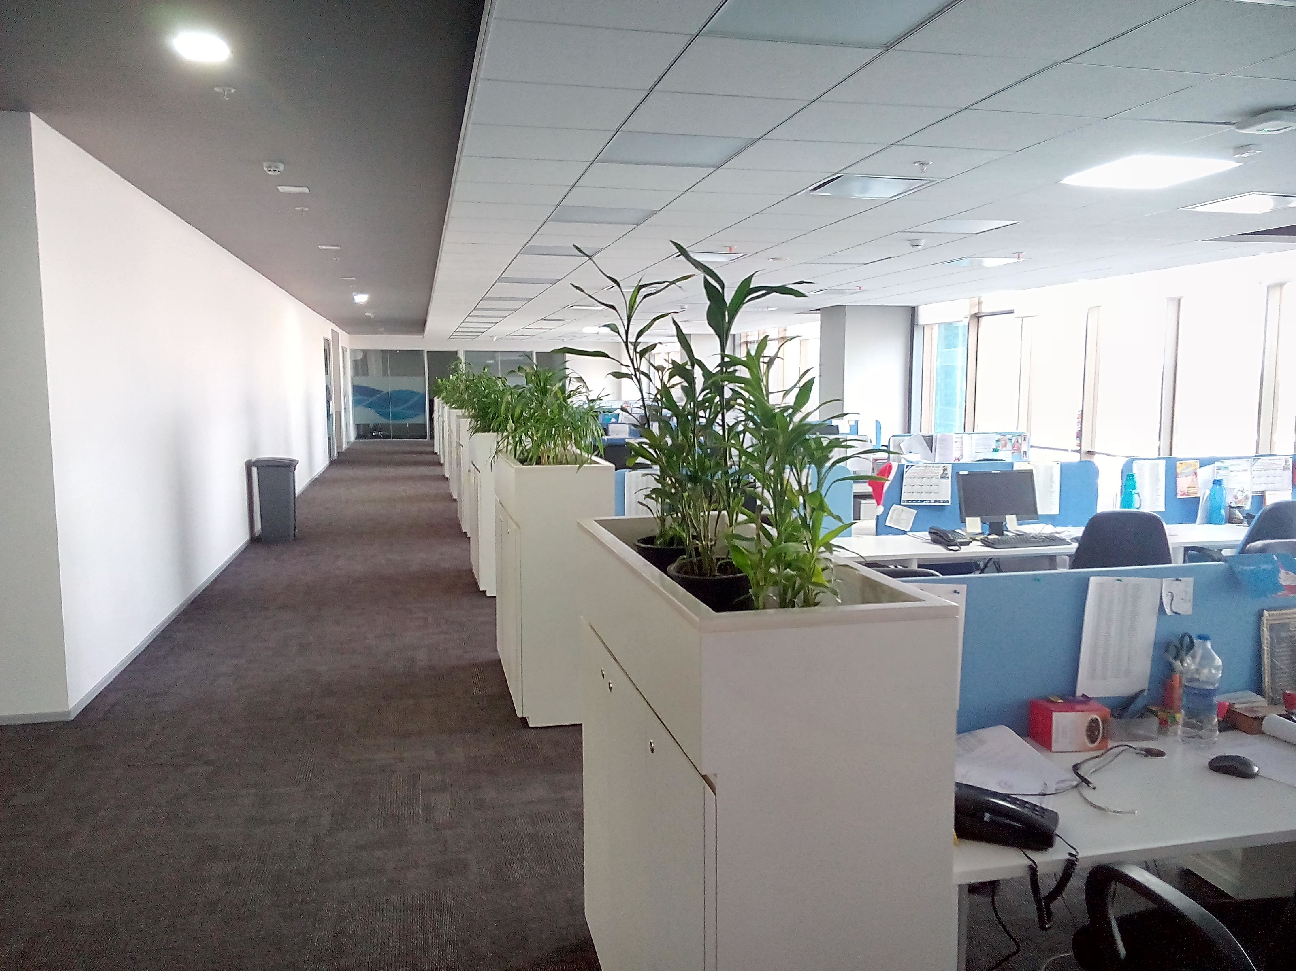
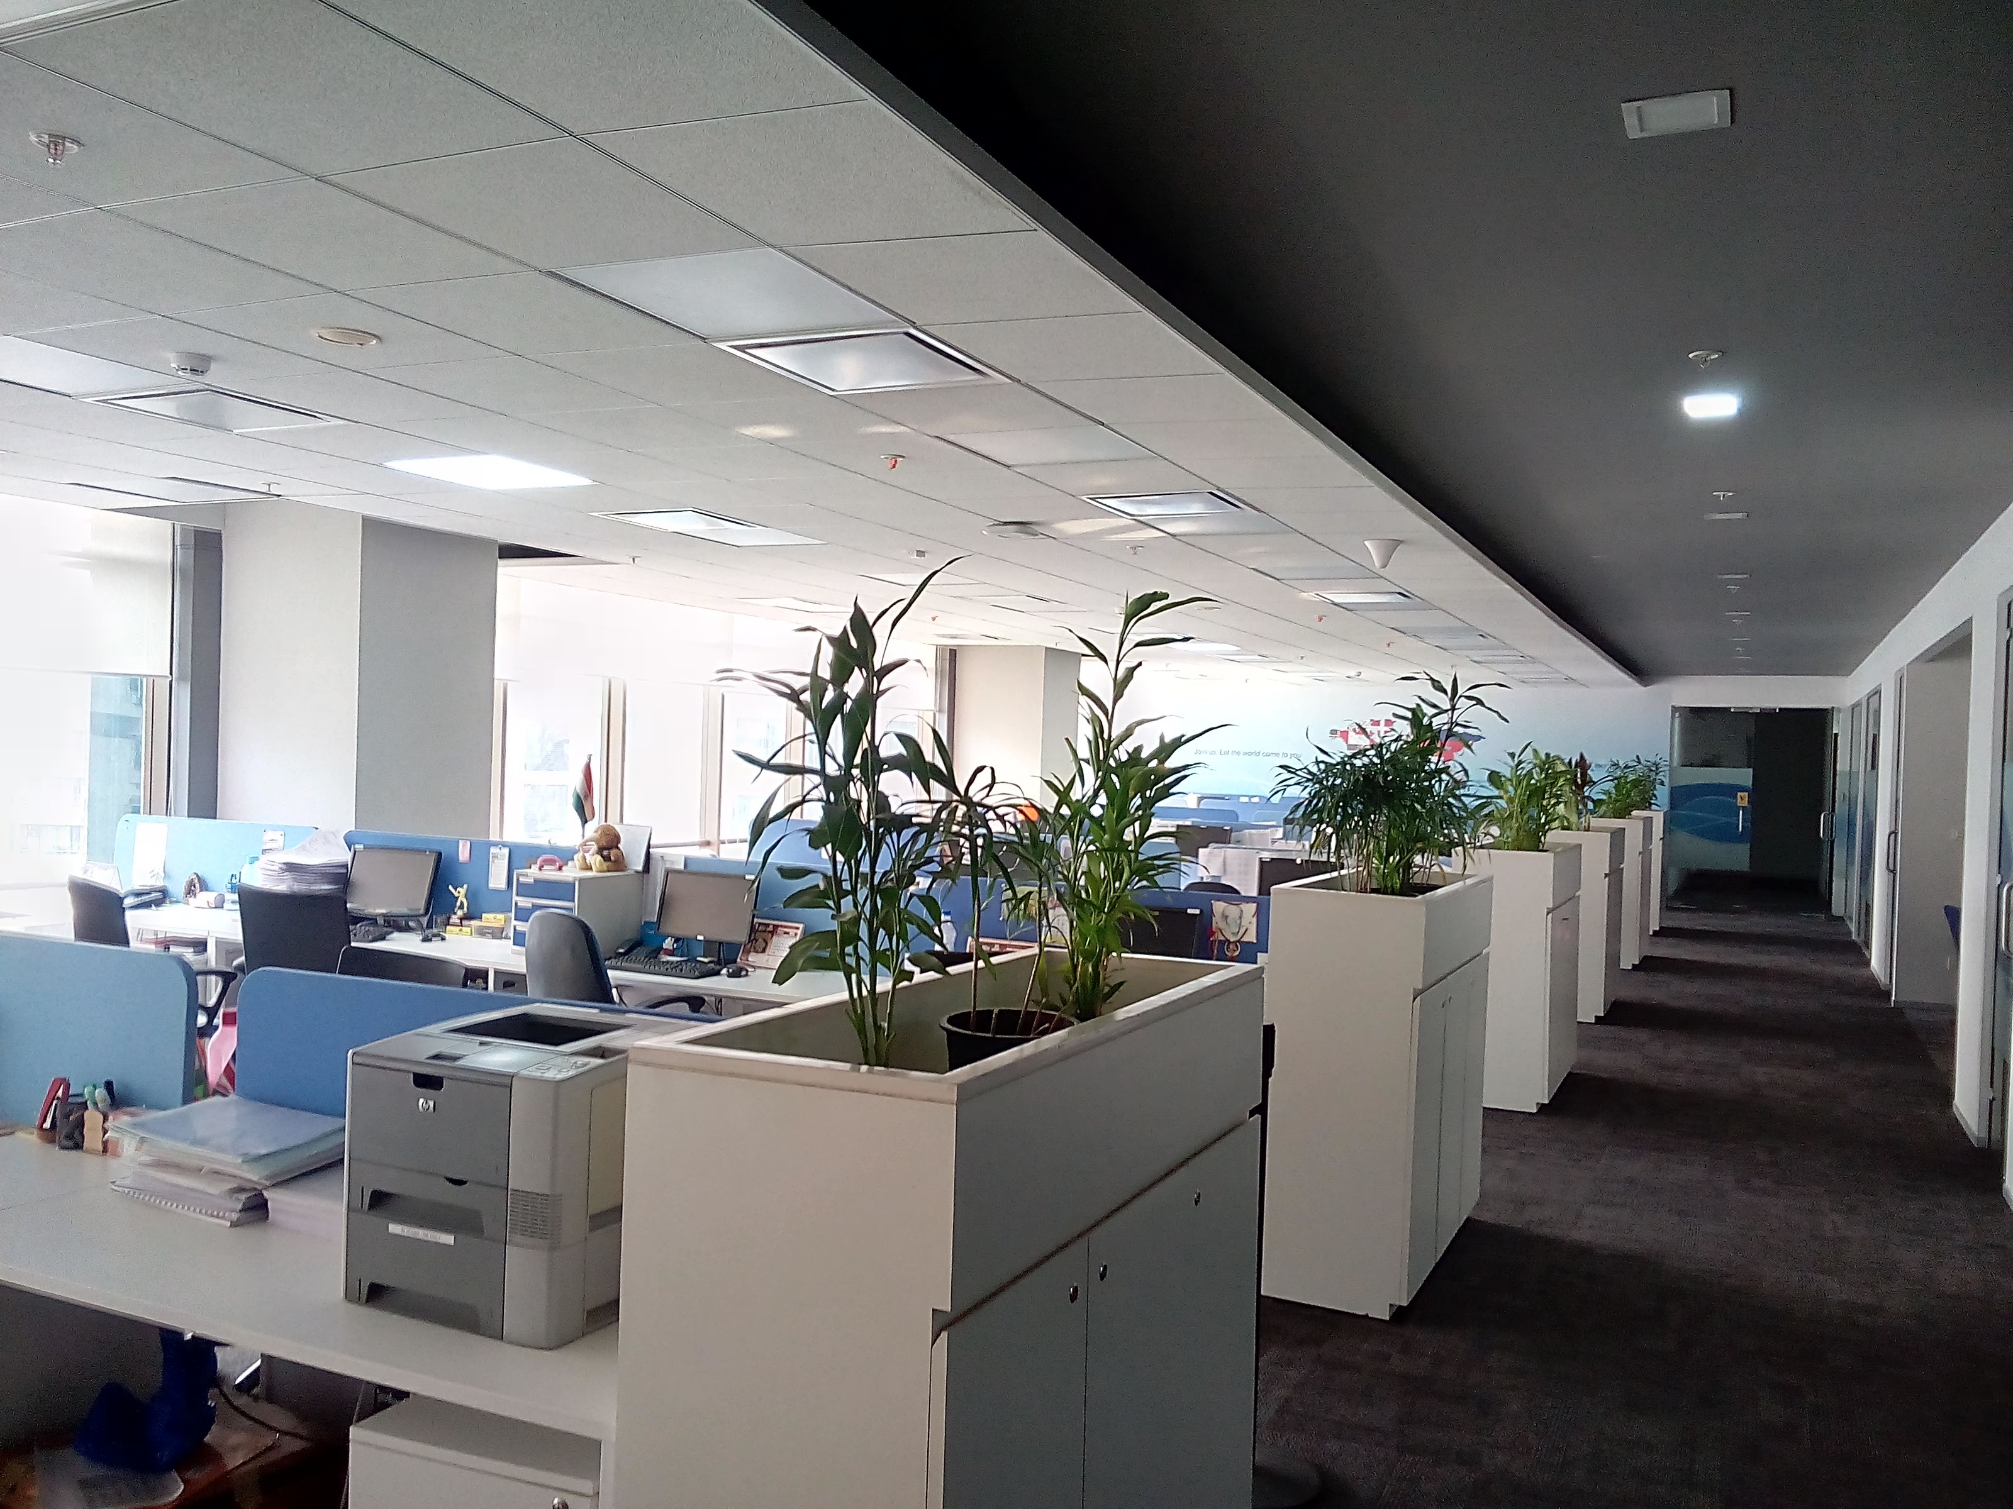
MUMBAI PROJECTs – FLEET MARITIME SERVICES INDIA LTD. VIDYAVIHAR, MUMBAI (15000 SQ. FT.)

Slide 4
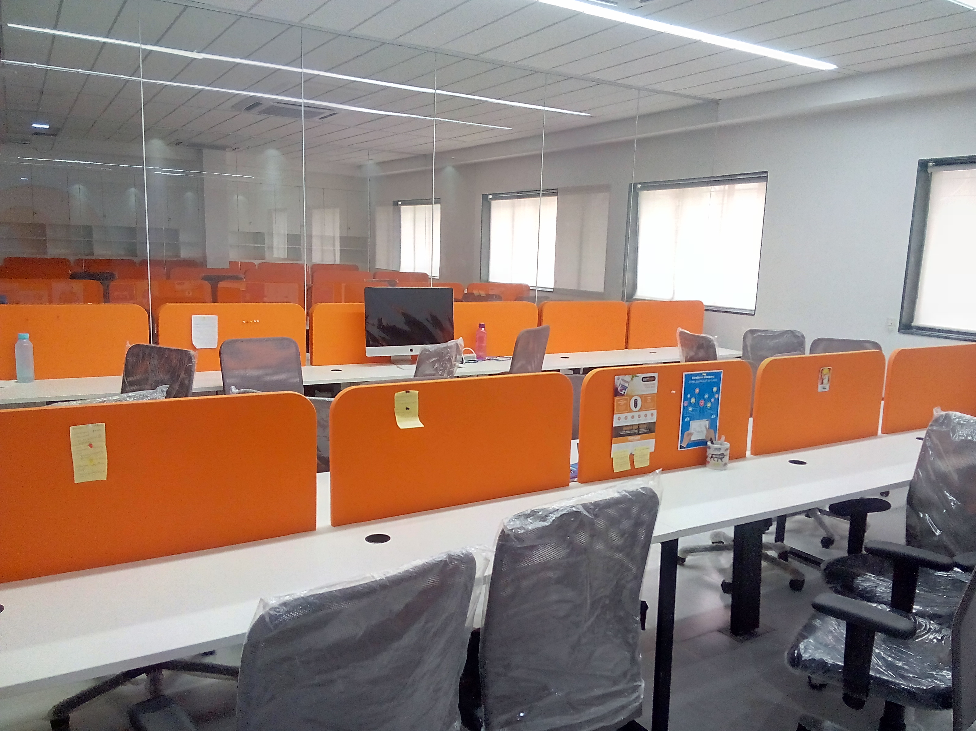
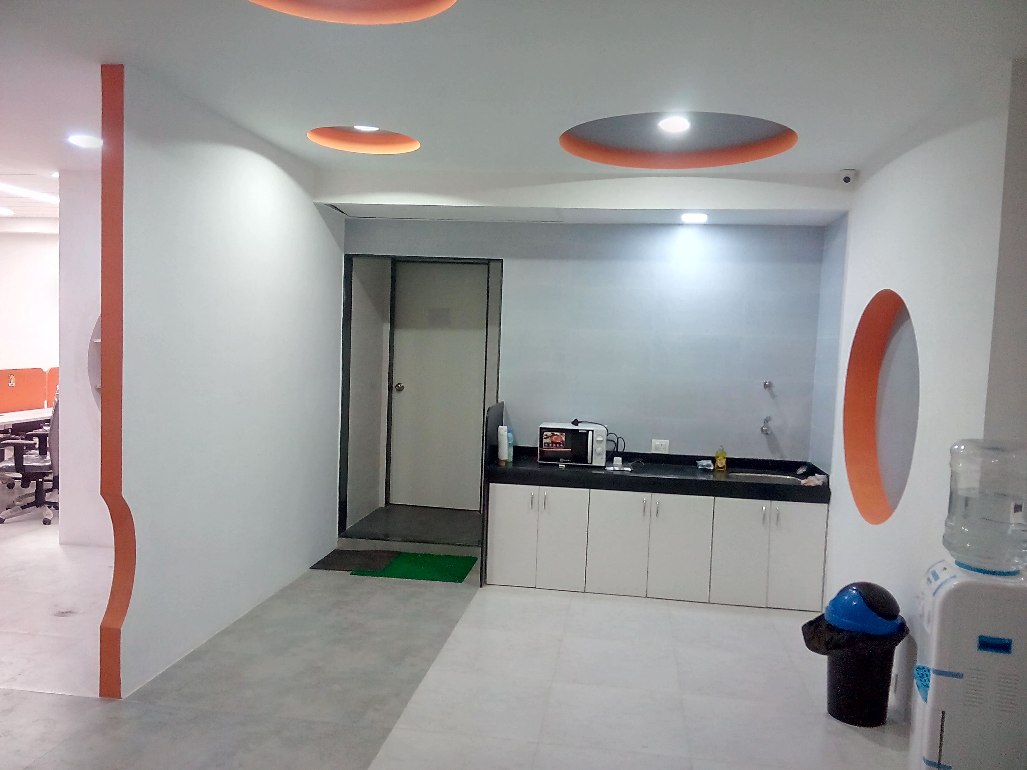
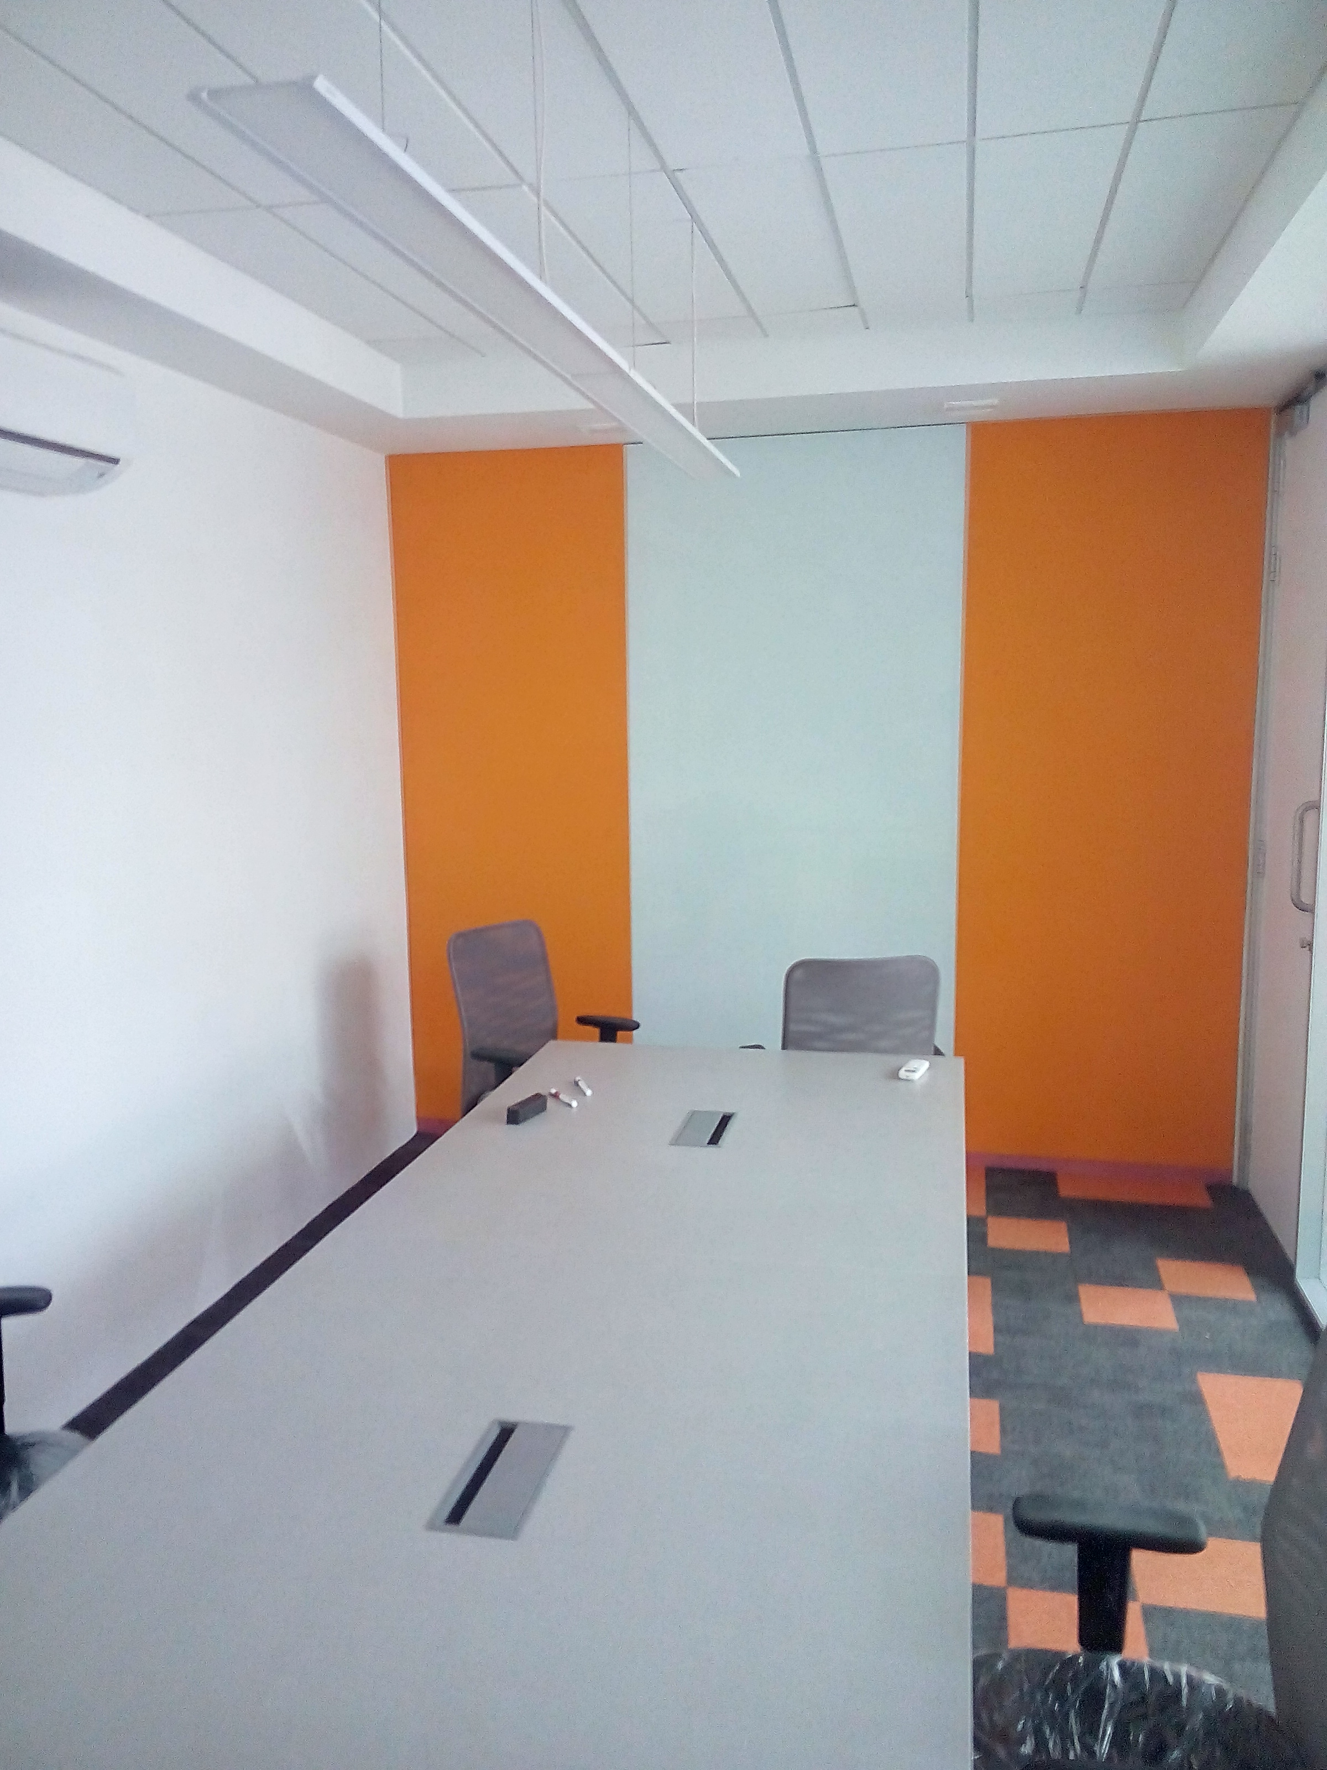
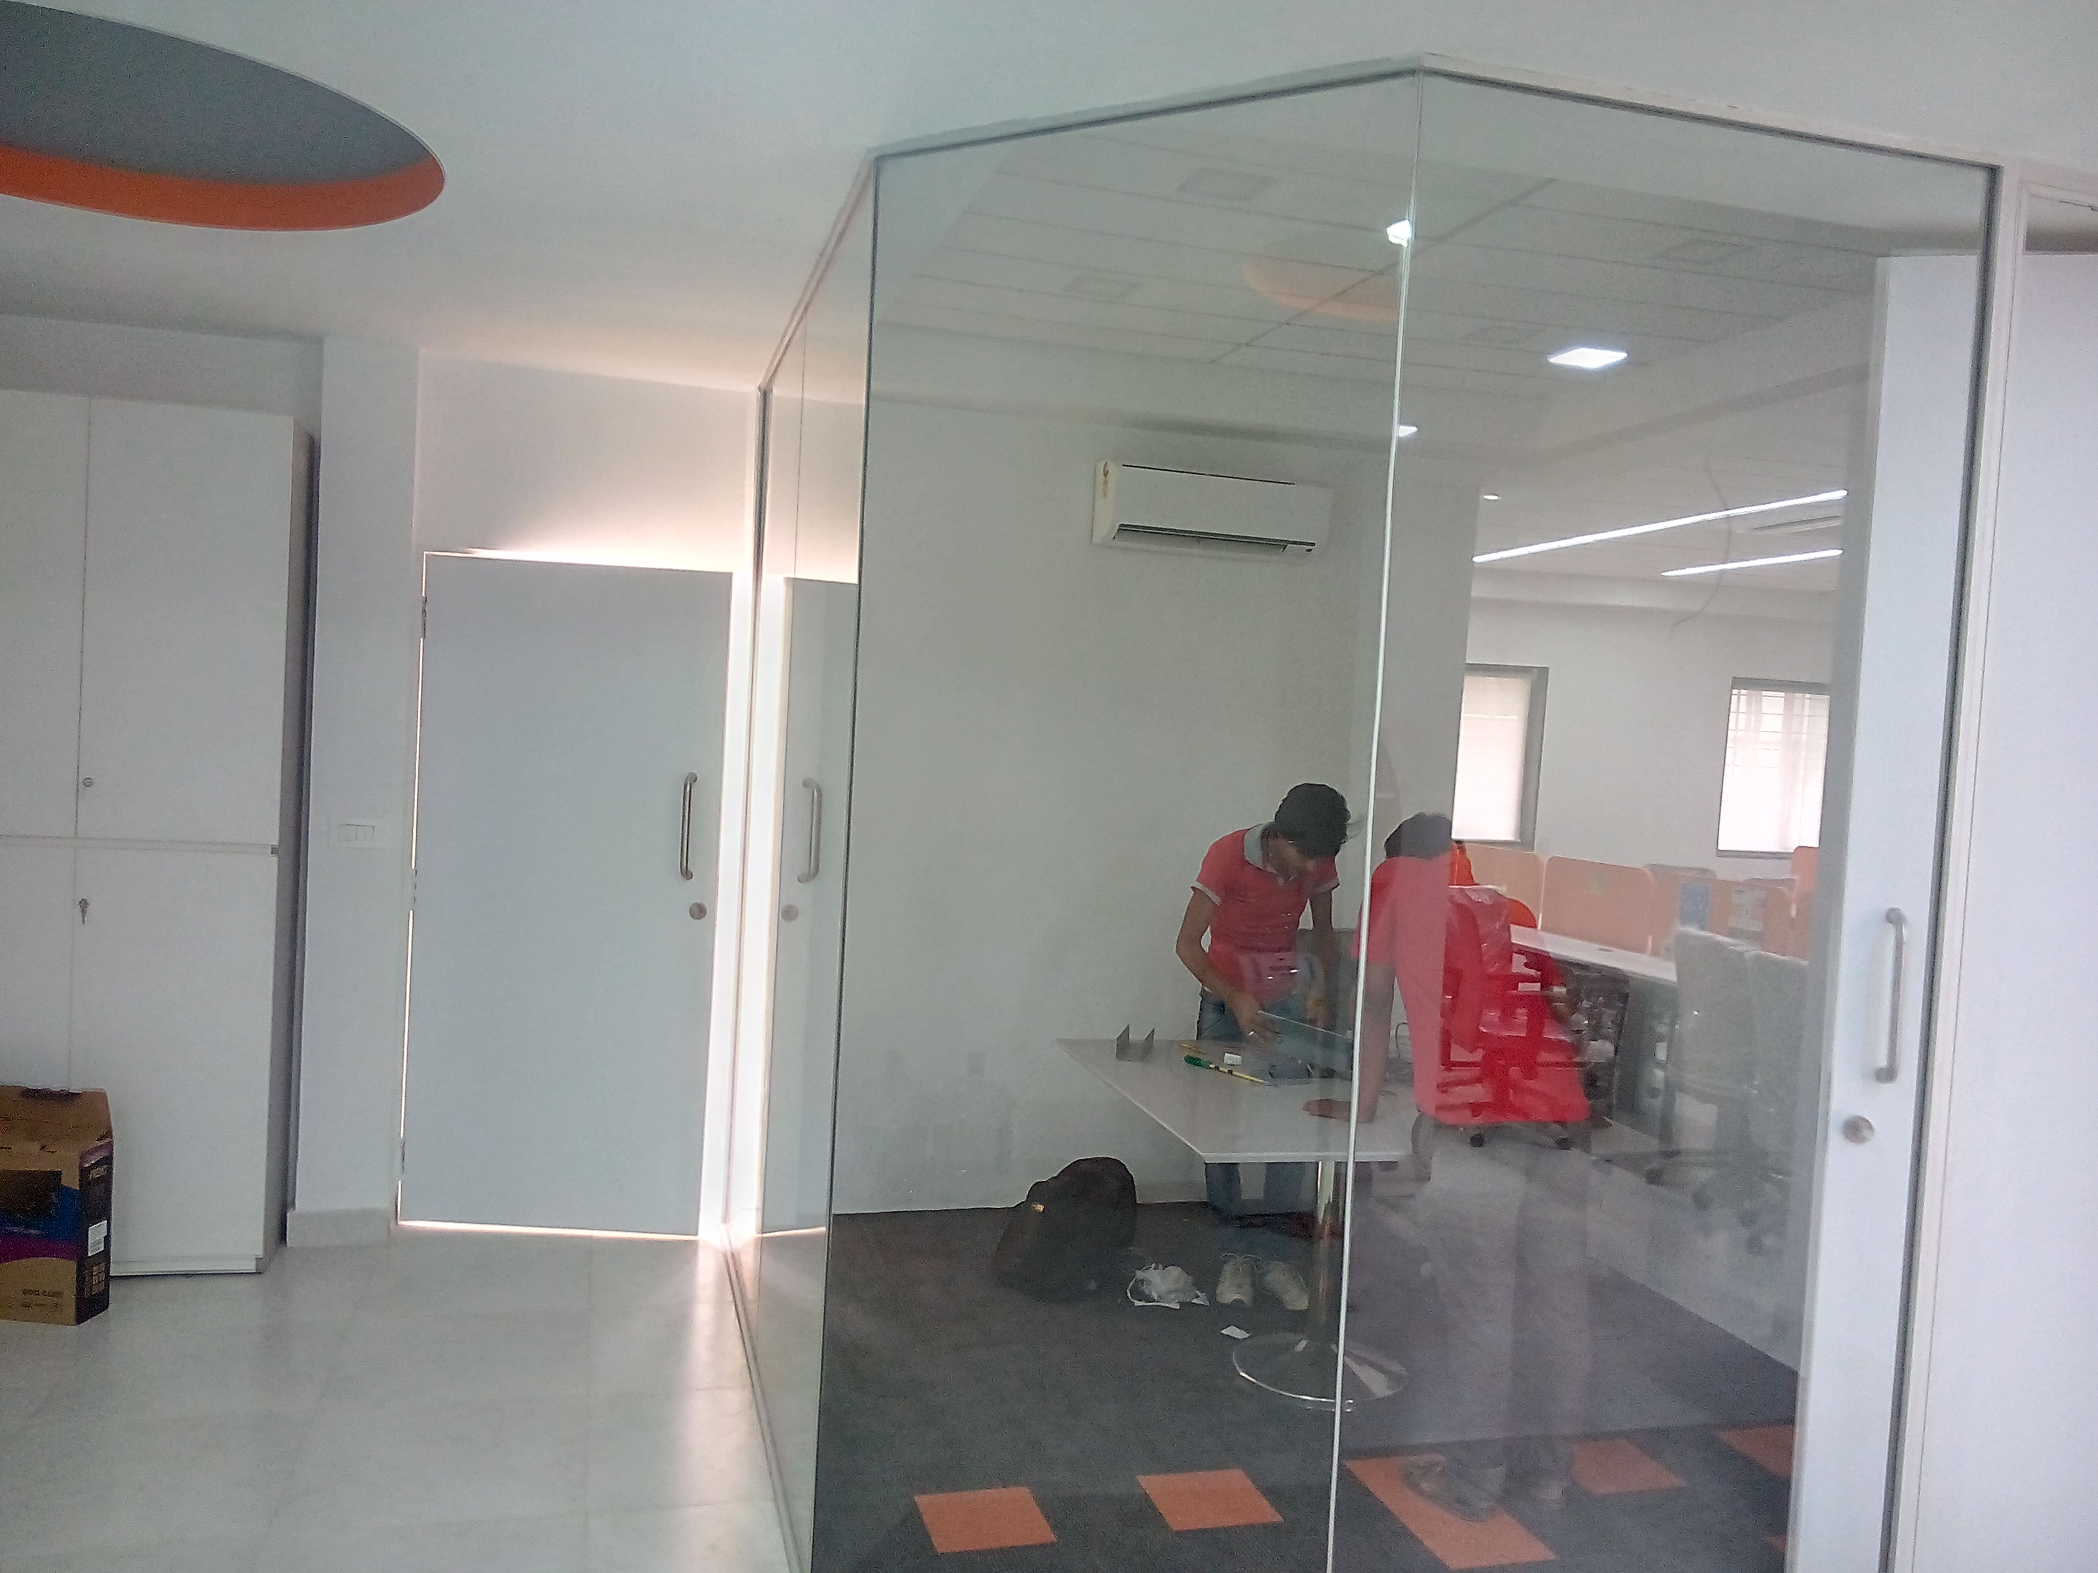
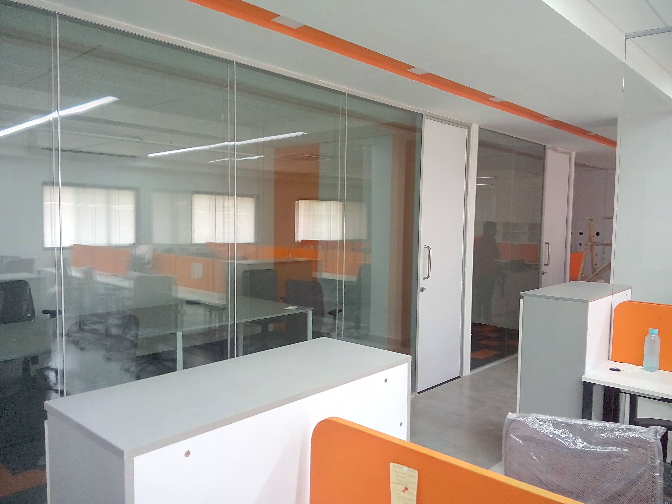
PROJECT – ADAPTY INC., THANE, MUMBAI ( 5500 SQ FT)

Slide 5
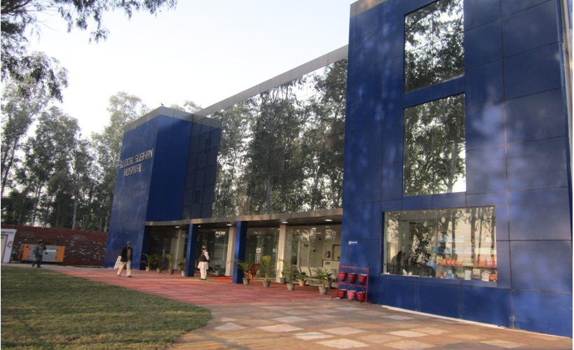
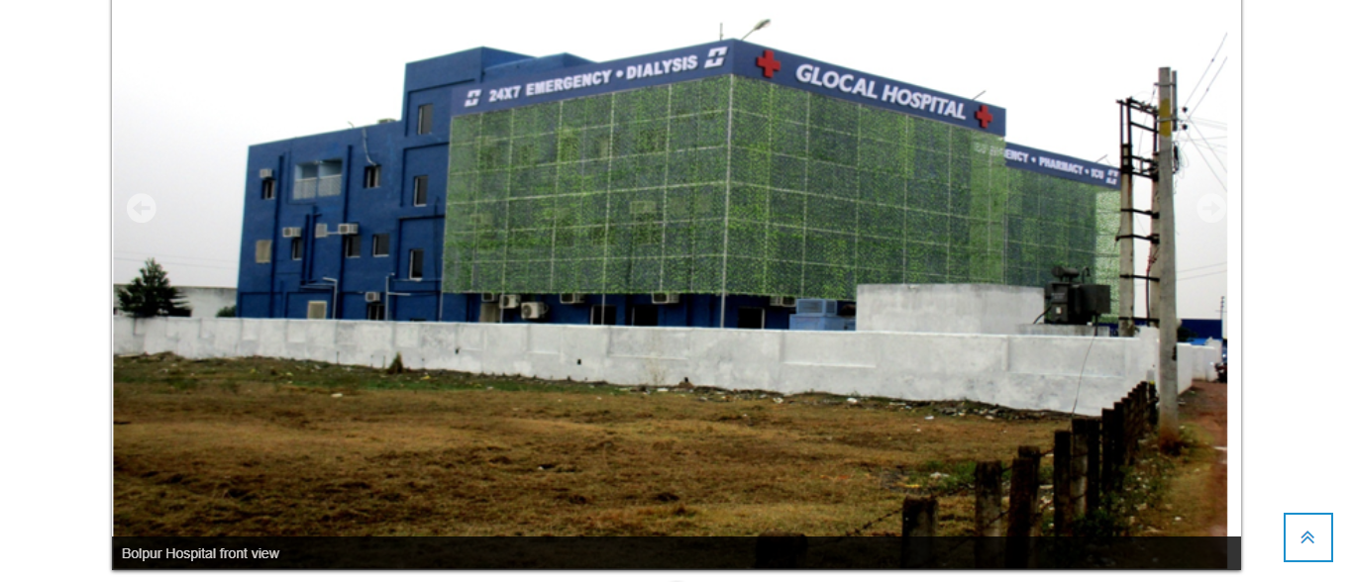
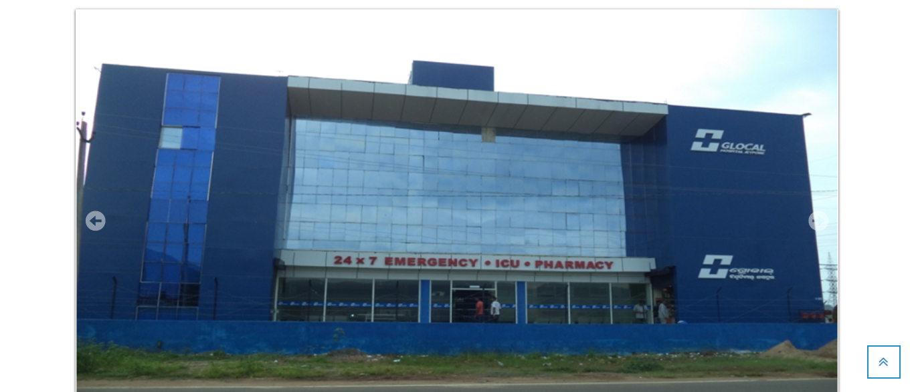
HOSPITAL PROJECTS :- HVAC WORK IN GLOCAL HOSPITAL IN AMROHA, KRISHNANAGAR, BOLPUR,BEGUSARAI,JEYPORE.(100 BEDDED HOSPITALS )

